Slide 1



Group 22
Fernando Bilbao - CpE
Harold Grafe - EE
Neysha Irizarry-Cardoza - CpE
Notes:
Neysha,Fernando & Harold

Slide 2
Motivation
Florida takes lead in the nation for the number of child fatalities due to drowning.
In 2017 there was a total of 51 that passed away from drowning. A 20% increase from 2016.
80% of fatalities reported, are from children of the ages 1-4 and 20% from children of the 15 and younger.
*Statistic are taken from the USA Swimming Foundation published by the Miami Herald.
Notes:
Neysha

Slide 3
Requirements Specifications
System shall be portable, durable and have a waterproof housing
Up to 10 lbs
System shall have solar power capabilities to sustain battery life
16 hours between charges
System shall have wireless communication capabilities
Communicate with mobile application
System shall be triggered when PIR sensor and/or accelerometer are tripped
Audible alarm when triggered
Visual verification through a camera when triggered
Notes:
Neysha

Slide 4
Work Distribution
NAME | POWER | MECHANICAL DESIGN | MOBILE APPLICATION | CONTROLLER
Fernando |  | Secondary | Secondary | Primary
Harold | Primary | Primary
Neysha |  |  | Primary | Secondary
Notes:
Neysha, Fernando, Harold

Slide 5
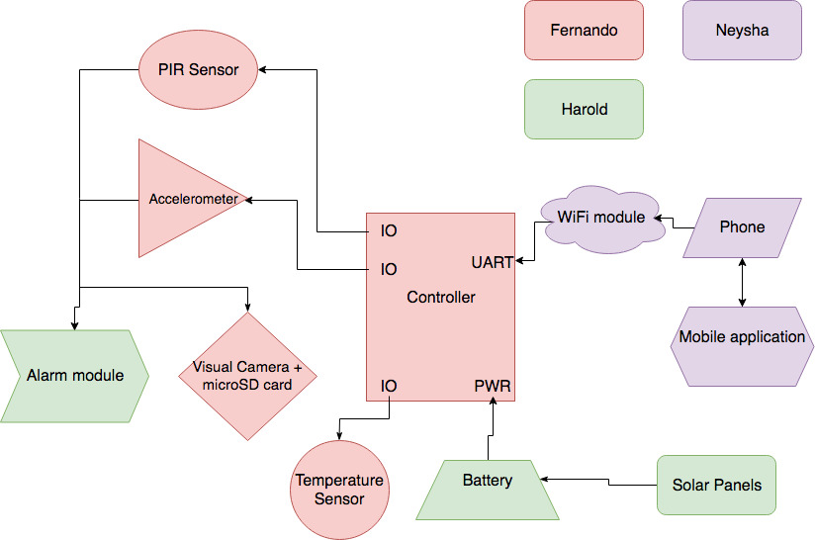
Overall Block Diagram
Notes:
Fernando

Slide 6
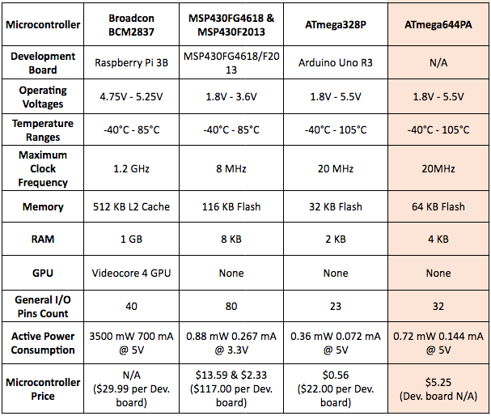
Microcontroller Comparison
Why did we choose the ATmega644PA?
Low power consumption
Price
Memory & RAM
Based on Arduino platform
Notes:
Fernando

Slide 7
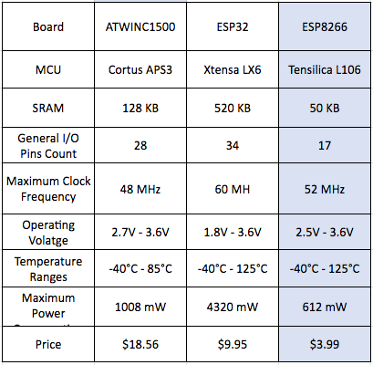
Wireless Communication Comparison
Why did we choose the ESP8266?
Maximum power consumption is the lowest compared to the others
Operates with 2.4 GHz wireless frequency
Price
Notes:
Fernando

Slide 8
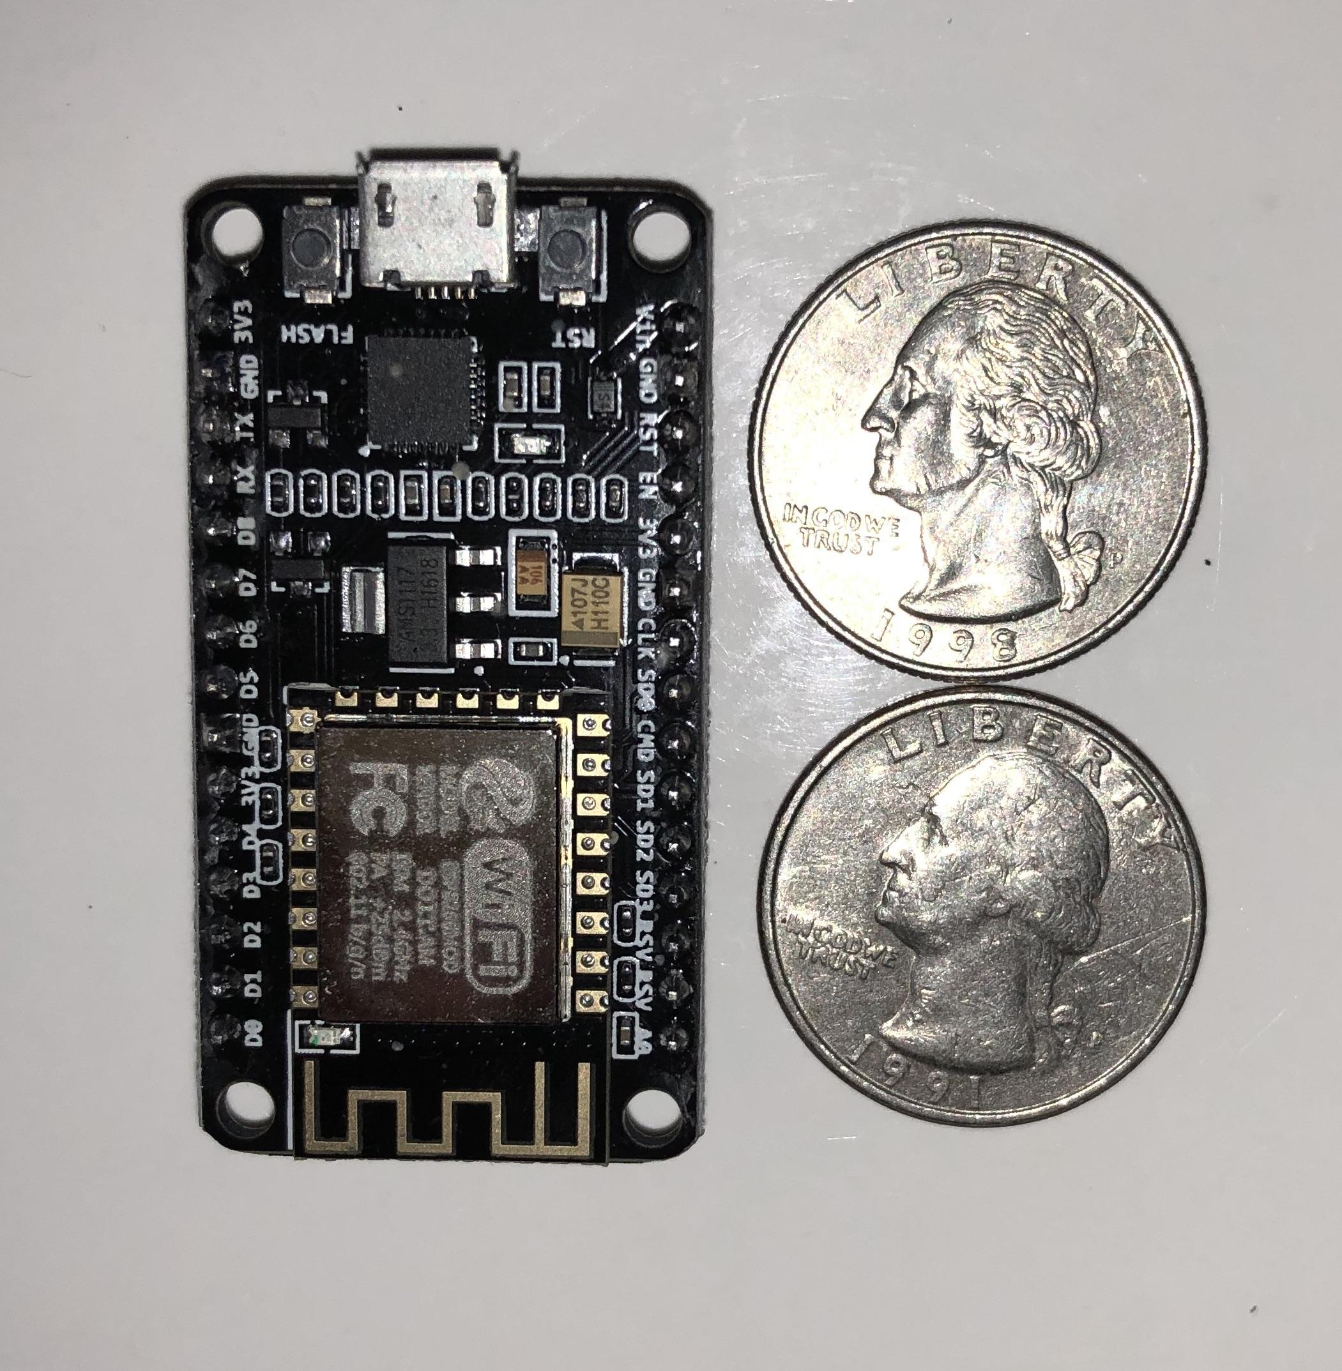
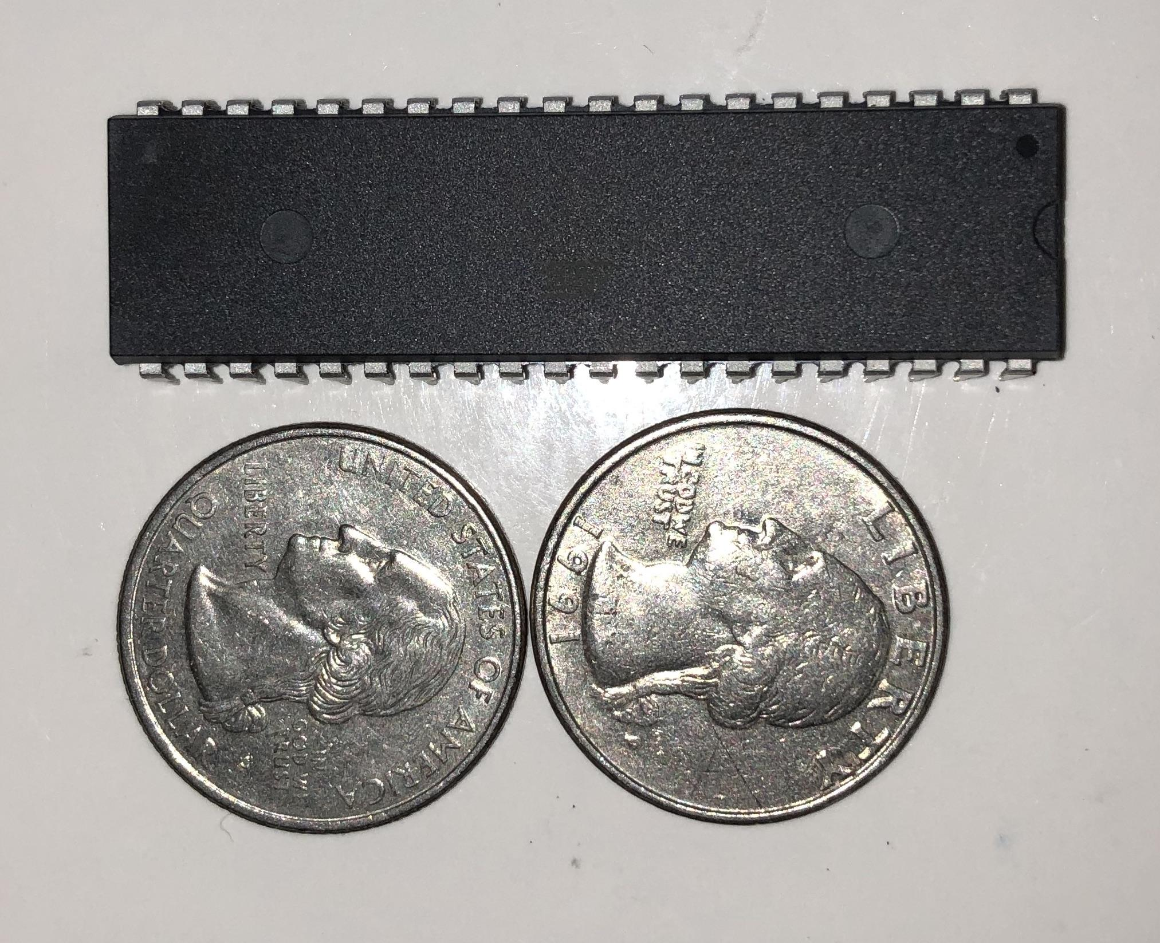
Wireless Board and Microcontroller Size
Notes:
Fernando

Slide 9
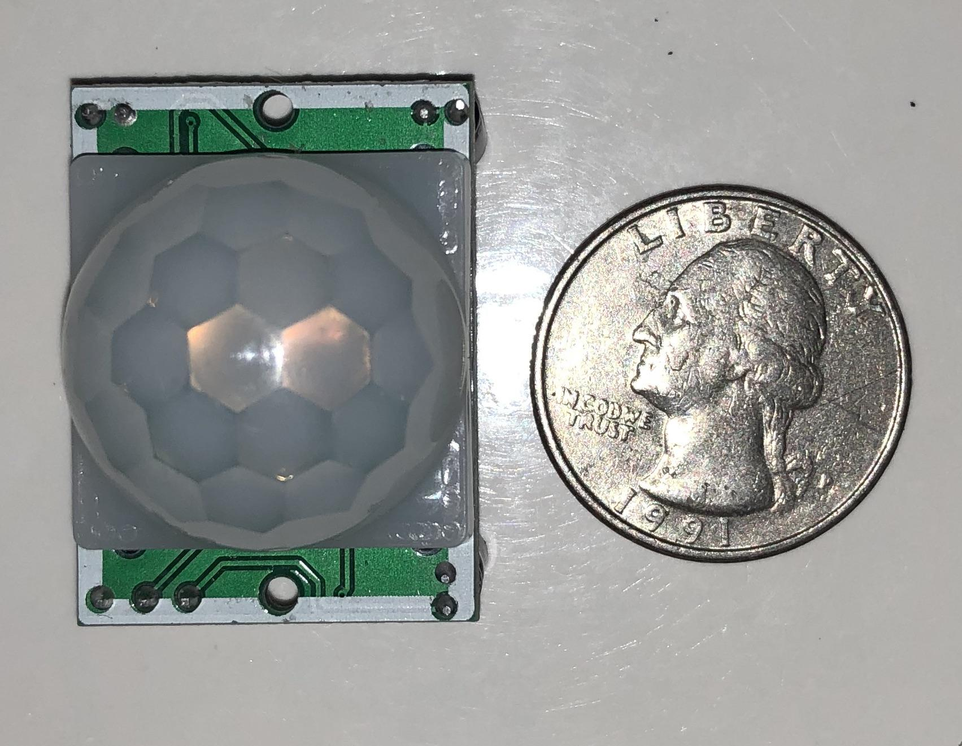
PIR Sensor
Passive sensor that catches energy (IR) emitted from bodies
P/N: HC-SR501
3 pins
VCC
OUTPUT
GND
Operating power consumption @ 5V
325 mW | 65 mA
Notes:
Fernando

Slide 10
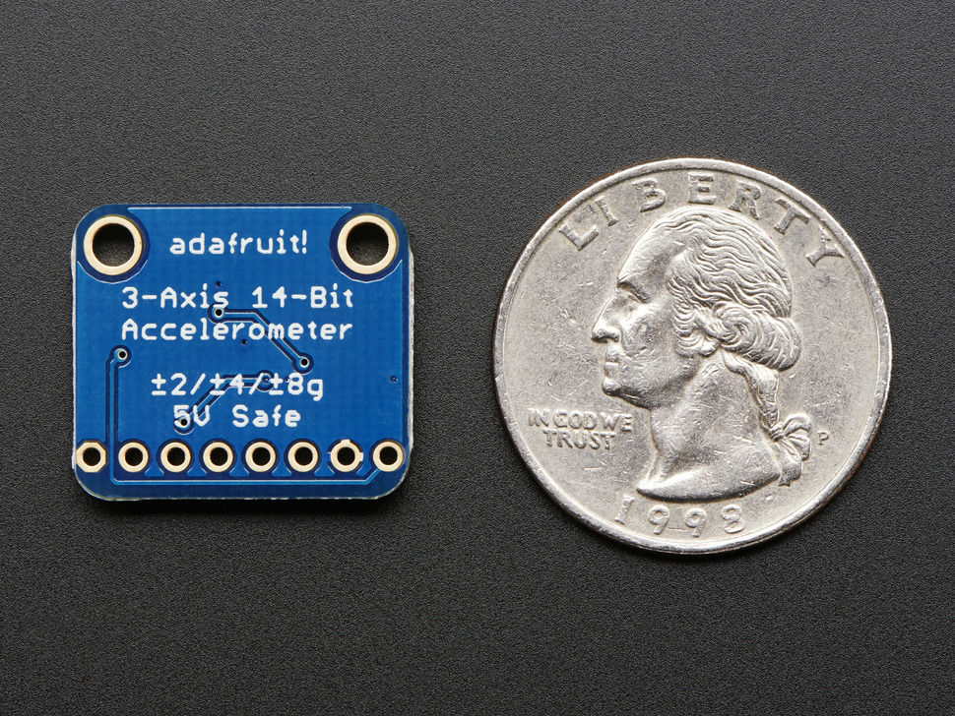
Accelerometer
Smart 3-axis accelerometer to detect motion, tilt and orientation
P/N: MMA8451
8 pins
Communicates via I2C
Operating power consumption @ 5V
425 µW | 85 µA
Notes:
Fernando

Slide 11
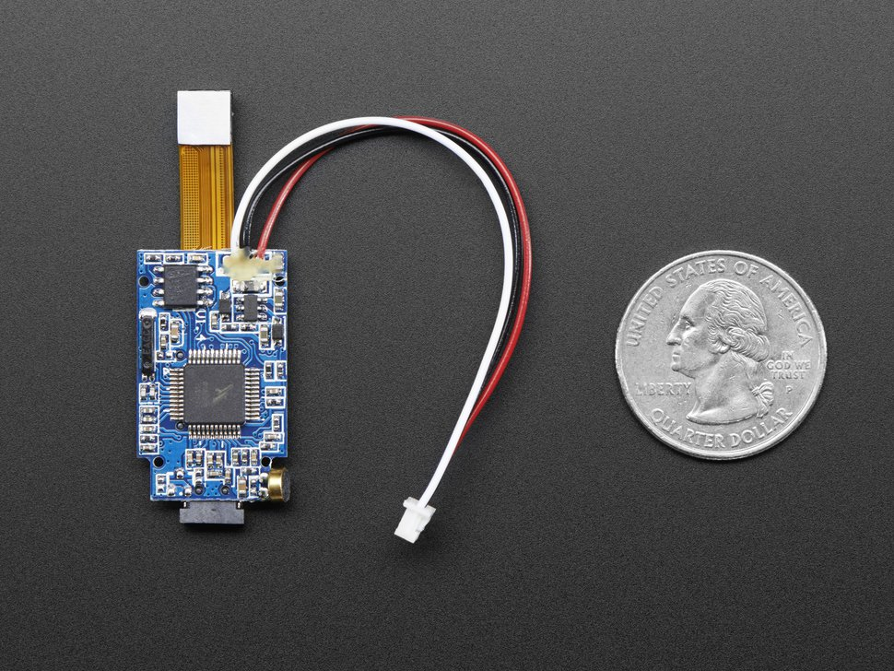
Mini Spy Camera
Takes pictures or videos and stores them to integrated microSD card
P/N: Adafruit 3202
3 pins
VCC
OUTPUT
GND
Camera resolution
1280 x 720 for pictures (JPEG)
640 x 480 for videos (AVI)
32 GB maximum microSD card support
Operating power consumption @ 5V
550 mW | 110 mA
Notes:
Fernando

Slide 12
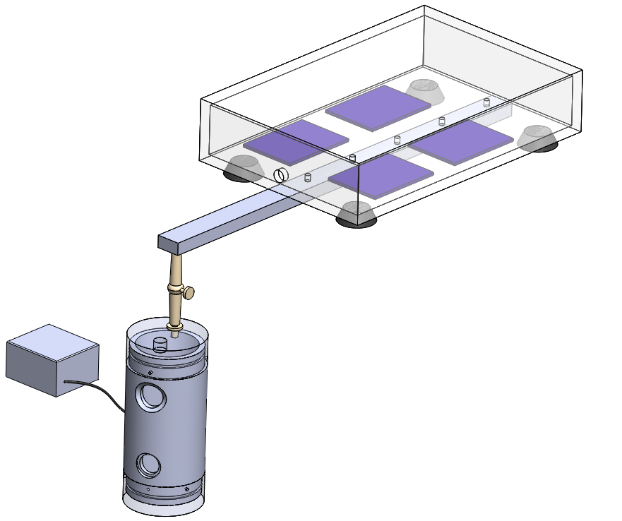
Physical Design/Prototyping
Waterproof solar cell and electronics housings
Clear acrylic for solar cell housing to allow sunlight through
Anodized aluminum electronics housing to prevent oxidation
Two windows for the PIR sensor and camera
Articulated arm to adjust electronics housing in the water
Accelerometer buoy attached to the side via wire
Aluminum rod suspends electronics housing over the edge of the pool
Notes:
Harold

Slide 13
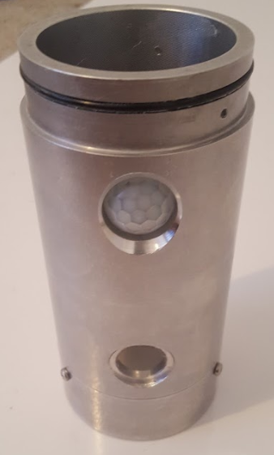
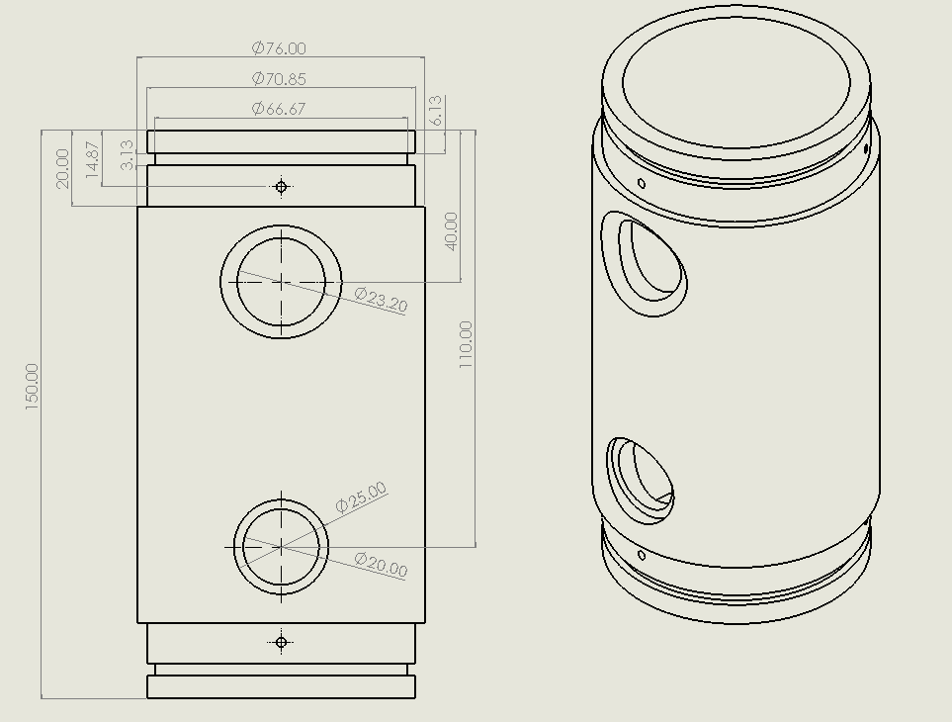
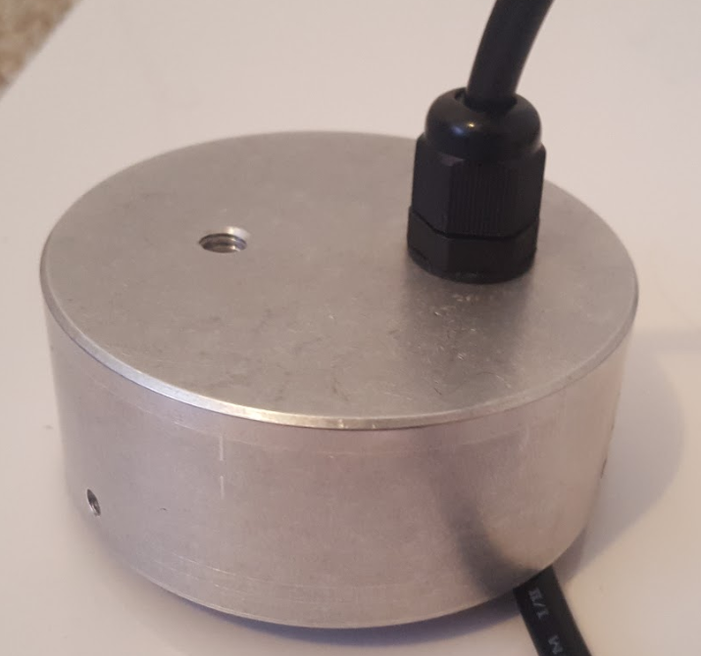
Electronics Housing
Sturdy aluminum construction
Waterproofed by 0.1mm tolerance between caps and body plus neoprene gasket
Caps are fastened with screws
Acrylic window at the bottom for camera
Top window is PIR lense included with the sensor
Cable glands to pass wires from solar cell housing
Notes:
Harold

Slide 14
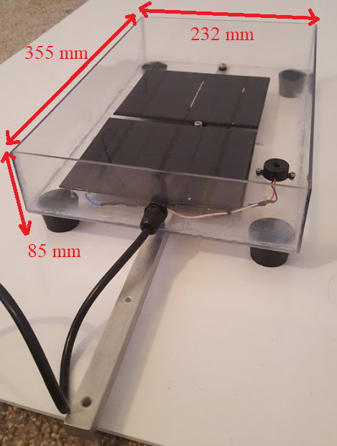
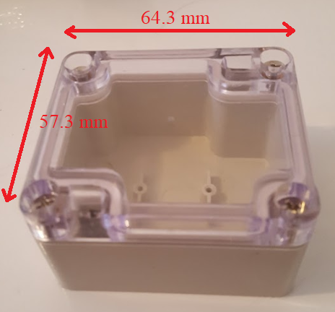
Accelerometer & Solar Cell Housing
Solar cell housing made to fit panels, buzzer, and WiFi antenna
Rubber legs to prevent slipping
Buzzer is included here to expand the range of the alarm
WiFi antenna need to be outside electronics housing
Accelerometer buoy is waterproofed with gasket
Notes:
Harold

Slide 15
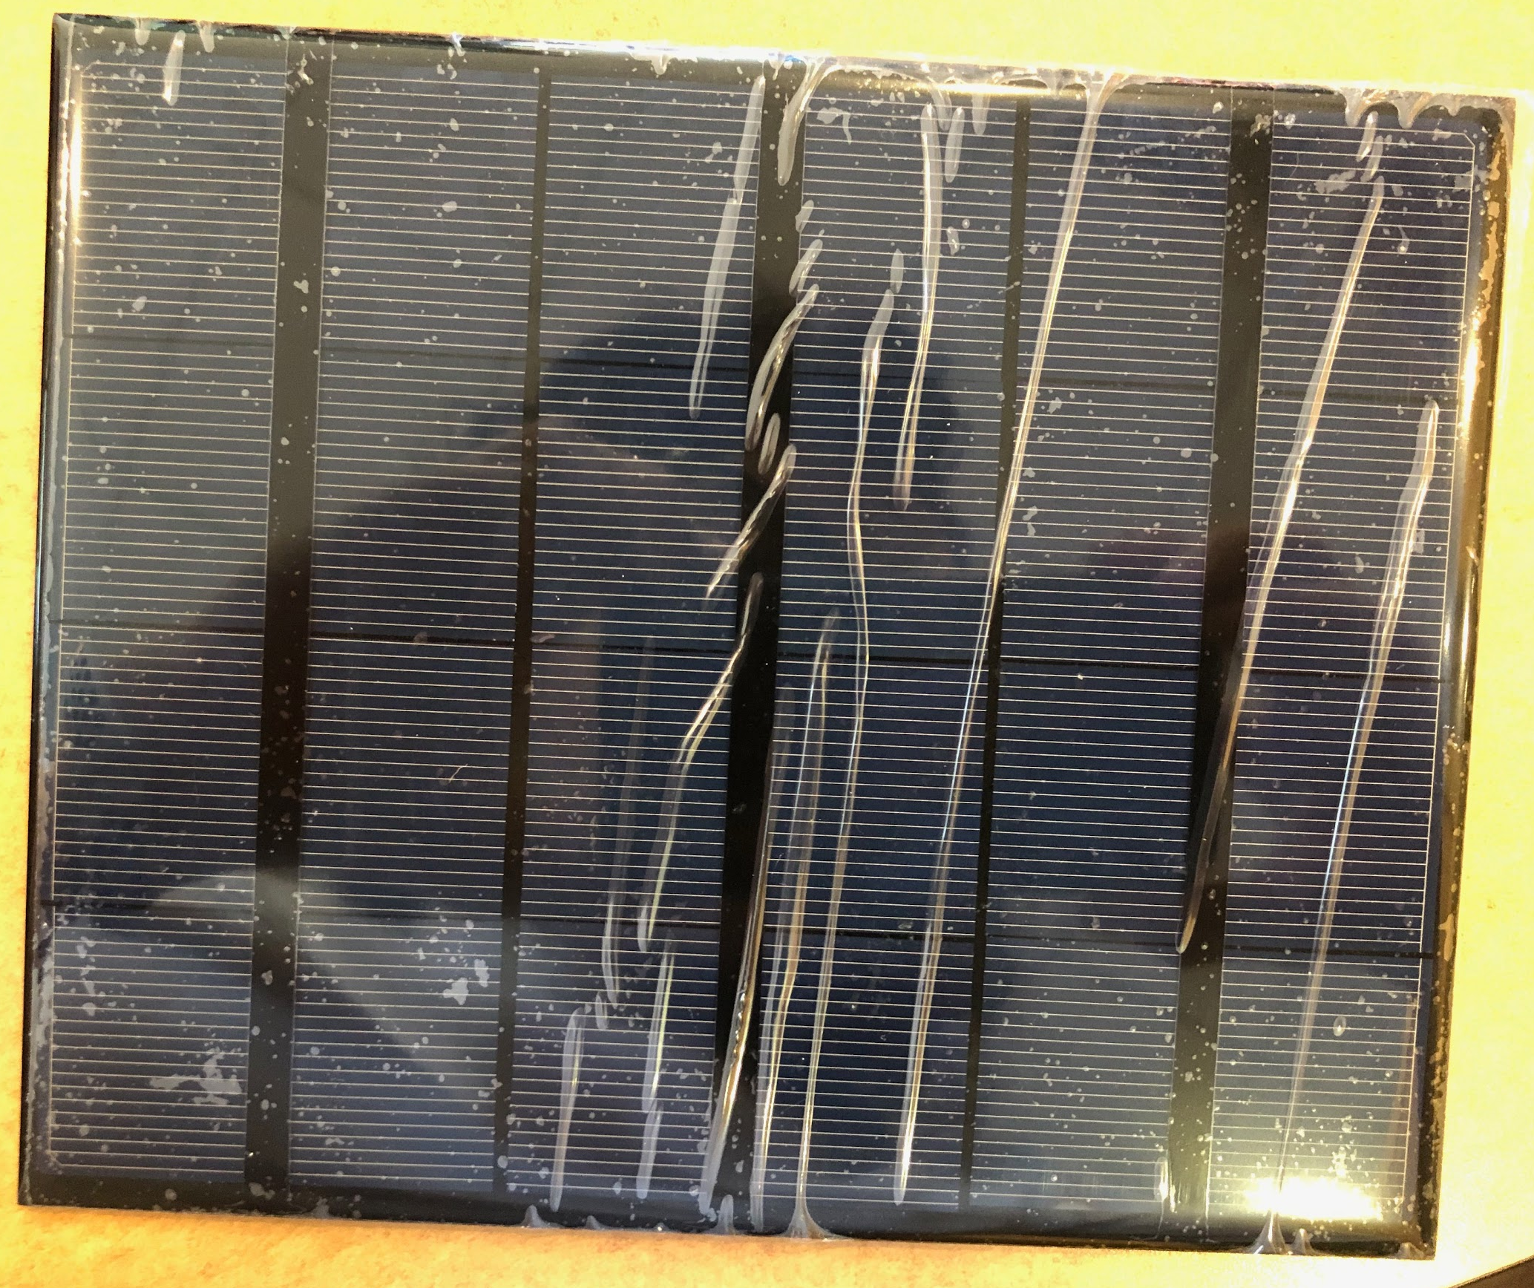
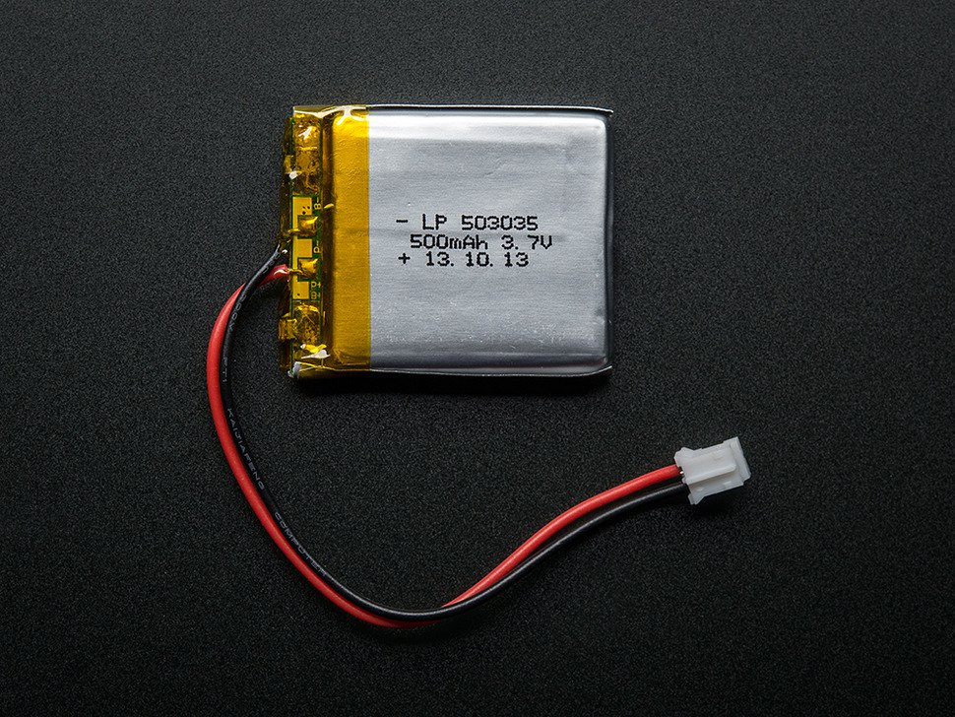
Power Management
Component | Max Current Draw (mA)
PIR Sensor | 65
Camera | 110
MCU | 0.4
WiFi Module | 170
Temp. Sensor | 0.05
Buzzer | 30
Accelerometer | 0.165
Total | 375.46
MCU and other components run on 5V
LiPo battery was used due to space constraints
Camera, WiFi, and buzzer only turn on when both the PIR and accelerometer give signal
235 mA/hr is needed under normal operation, assuming system runs on battery for 16 hrs a day, capacity of 3760 mAh is needed, 5000 mAh was chosen
Two solar cells with 600mA output in parallel were chosen to charge battery
5V switching boost converter was used to power system from 3.7V battery
Notes:
Harold

Slide 16
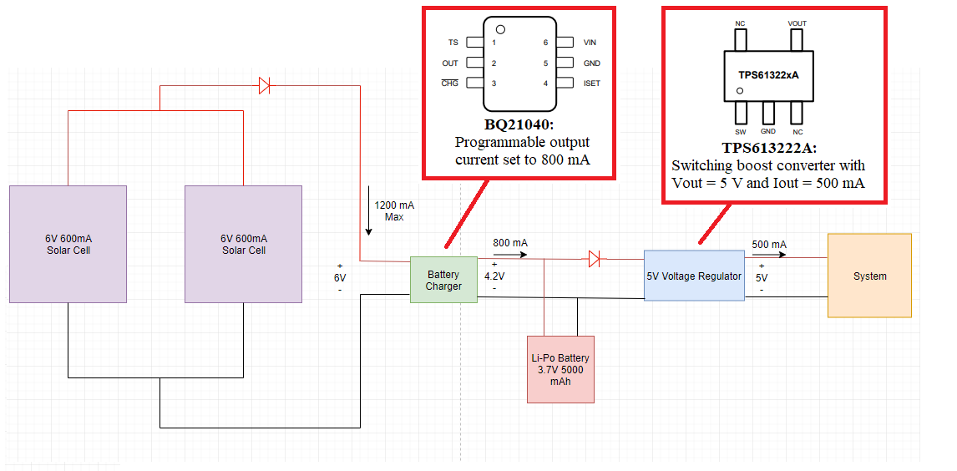
Power System Design
Notes:
Harold

Slide 17
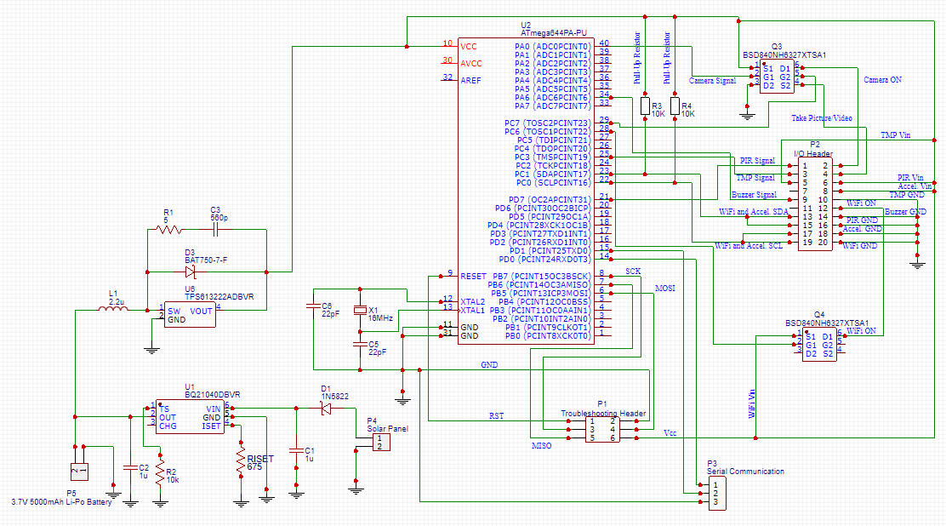
PCB Schematic
Notes:
Harold

Slide 18
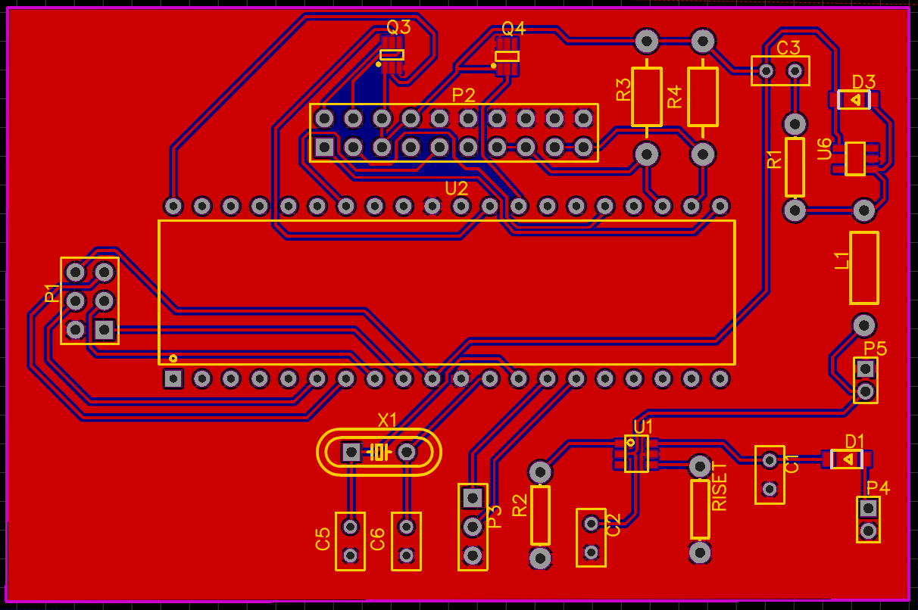
PCB Layout
Notes:
Harold

Slide 19
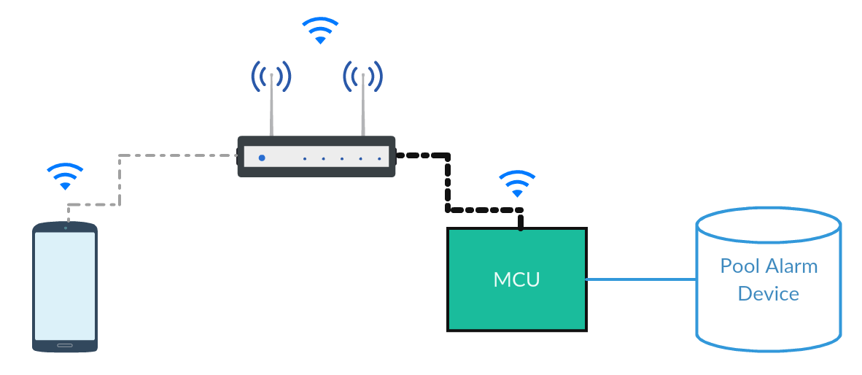
Mobile Application
The mobile application will serve as an extra beacon. Sending notification alerts, based on the activities being reported from the pool alarm.
Notes:
Neysha

Slide 20
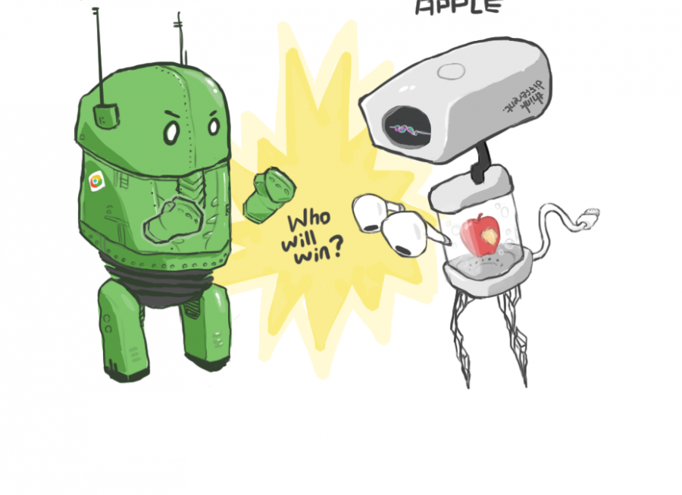
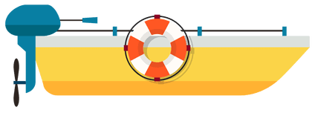
Mobile Operating System
iOS apps: Developed on Xcode and written using Swift language. Developer would need a Mac product (Desktop or Laptop). Development on Windows is possible but strenuous.
Android apps: Constructed on Android Studios. Written in Java. Developer would need just a basic computer or laptop. Android development is known to be more straightforward.
Fantasy: If time permits; development of mobile application in both platforms. Although Android is simpler, we would not want to limit our users to one possible operating system.
Notes:
Neysha

Slide 21
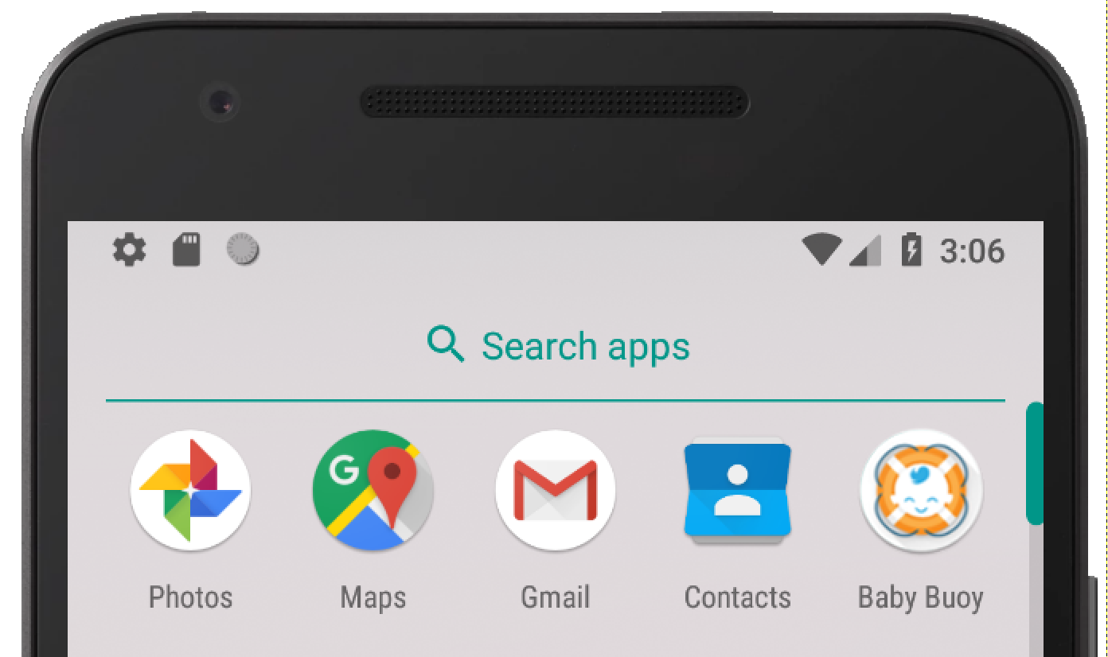
Mobile Application Features
Monitoring
Output logs of when sensors are activated do to motion detection.
Gallery of images captured from underwater camera.
Water temperature
Emergency push notification
Notes:
Neysha

Slide 22
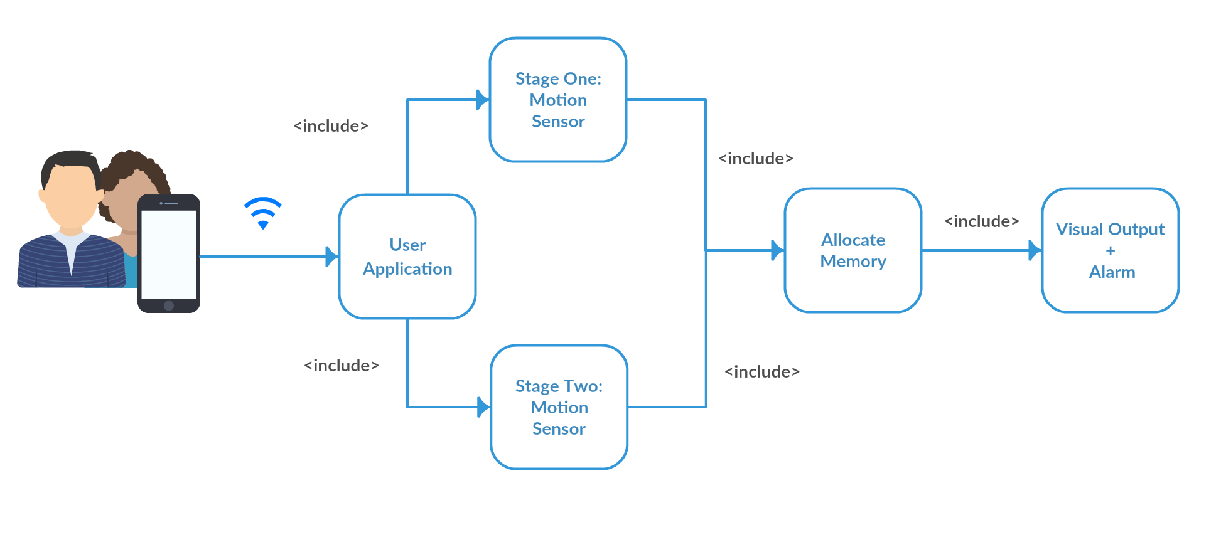
Use Case Diagram
Notes:
Neysha

Slide 23
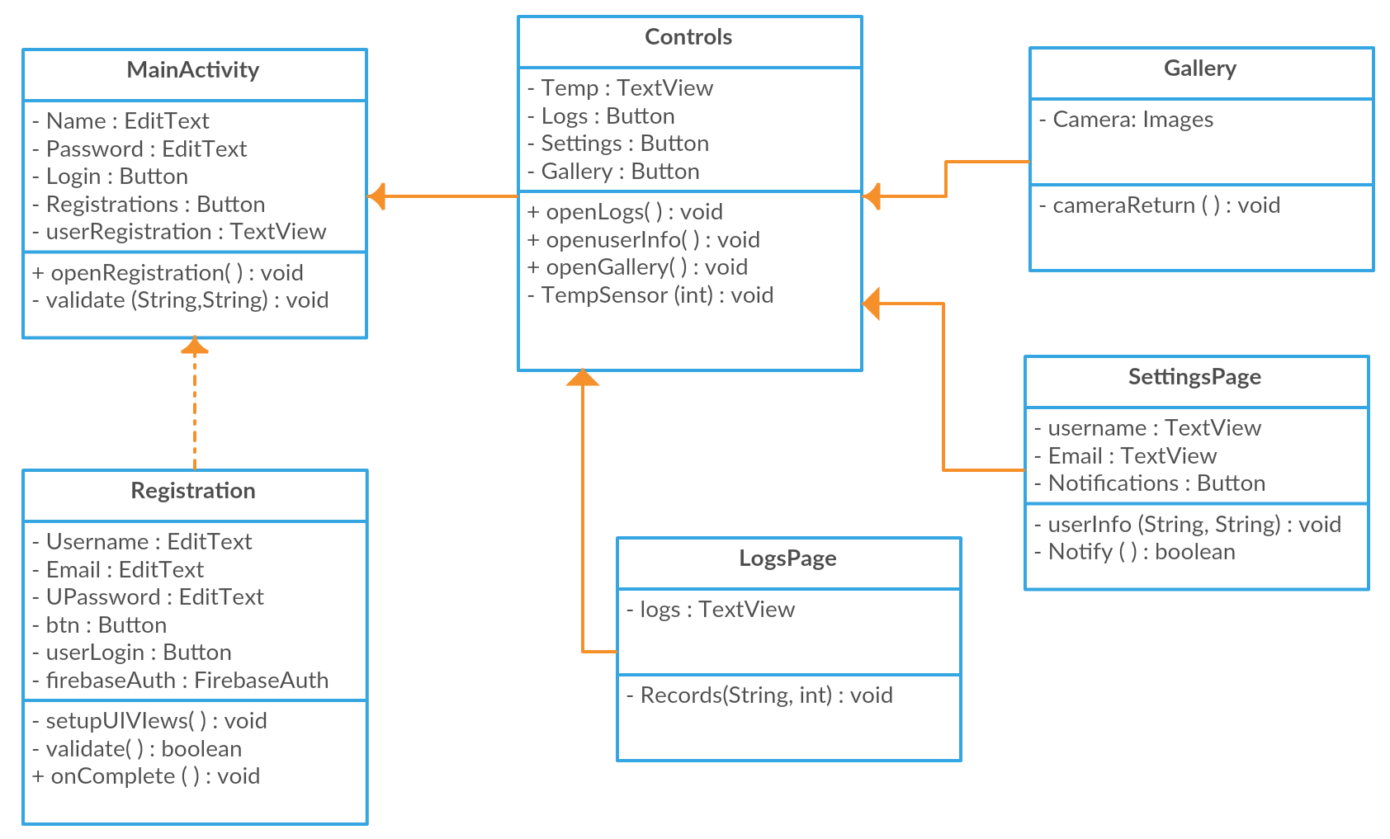
Class Diagram
Notes:
Neysha

Slide 24
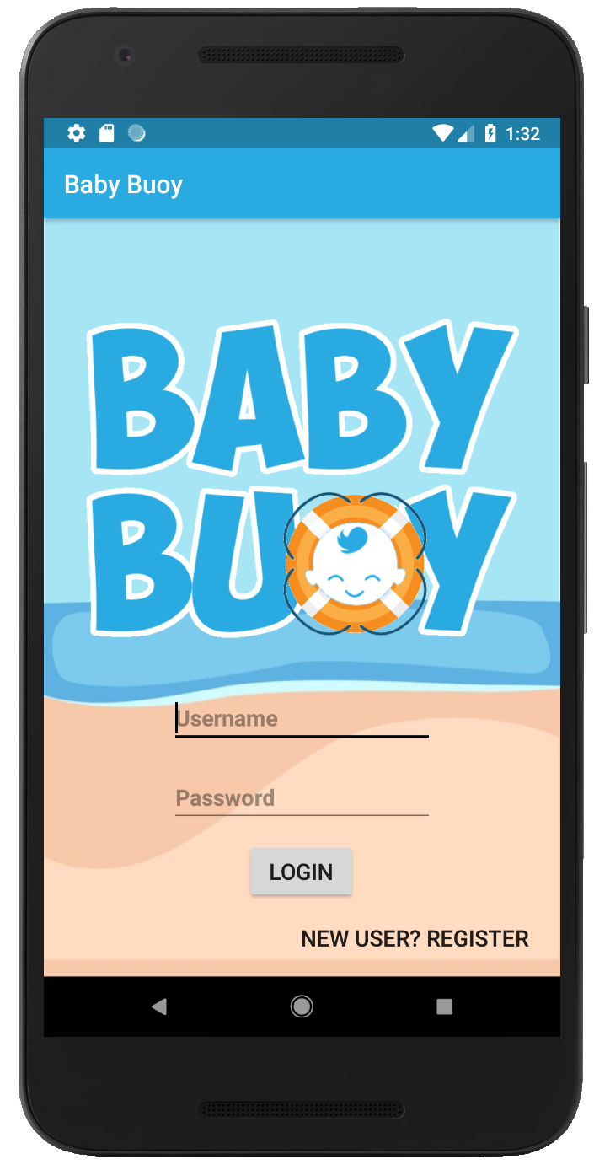
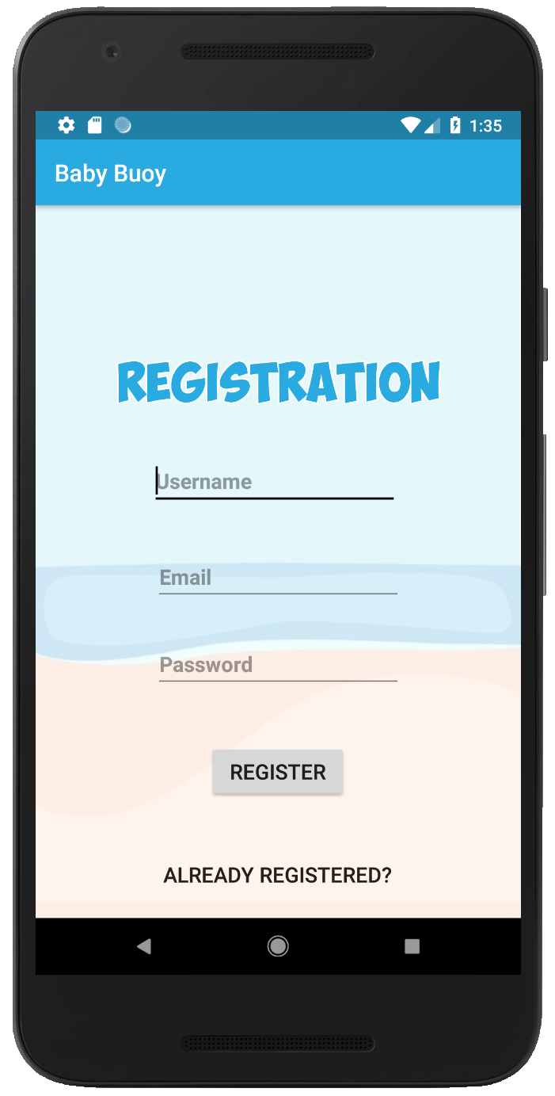
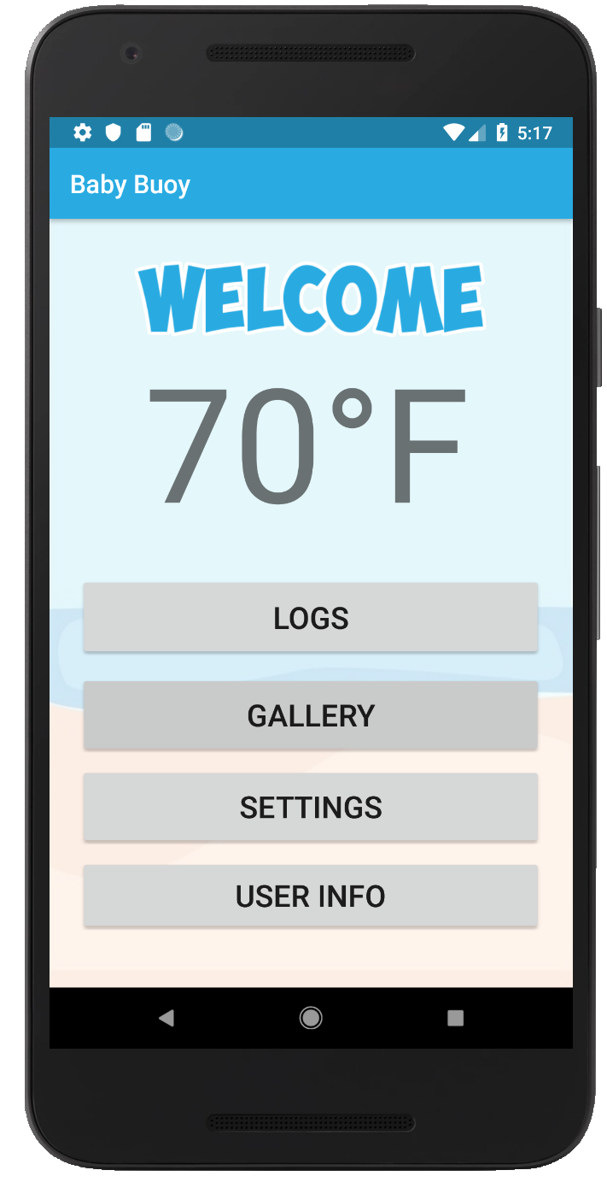
Mobile Application UI
Notes:
Neysha

Slide 25
Constraints & Standards
Economic Constraint: Self funded project. Keeping it cost friendly and competitive with other similar products out in the market.
Health and Safety Constraint: Child safety is our #1 concern. Keeping any dangerous and hazardous material sealed, covered and away from small rugrats.
IEC 60529 standard: Goes over what would classify an object to be protected from environmental elements. Based on their rating scale our project is scaled as a IP68. Meaning, dust tight and protected against immersion in water for long periods of time.
Notes:
Neysha

Slide 26
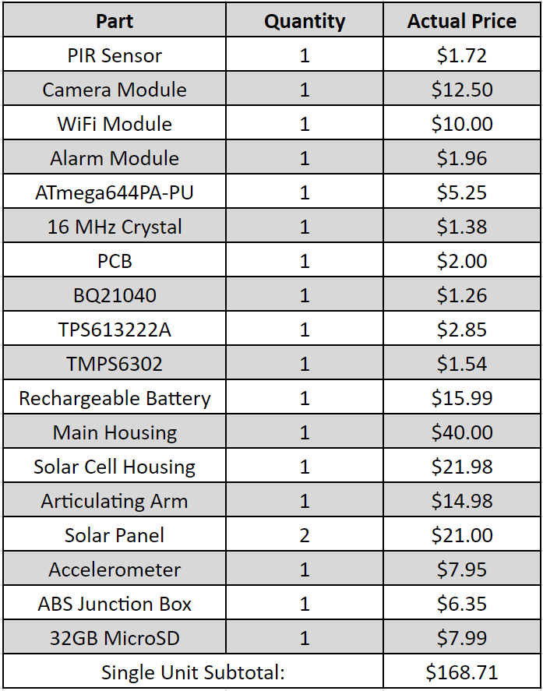
Budget
Self-sponsored project
Overall budget of $500 for research & development purposes
Retail price of $300
Similar devices are retailed at $300 to $420
Notes:
Fernando

Slide 27
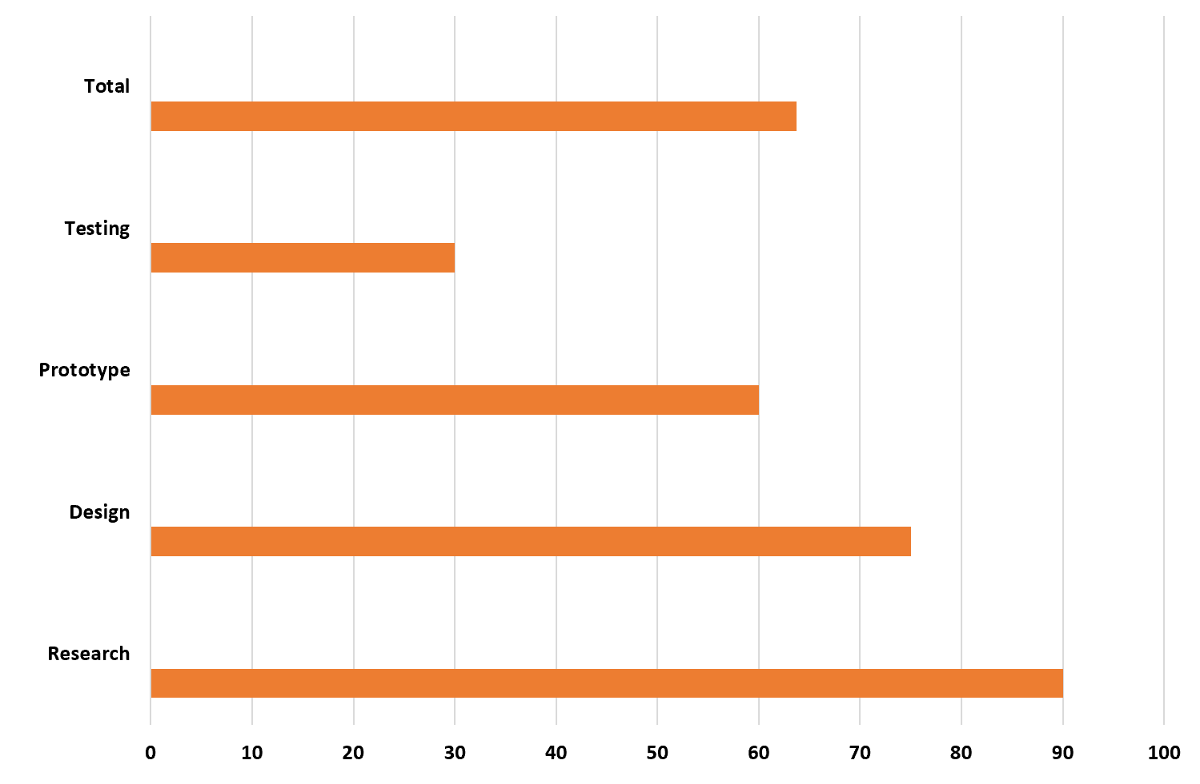
Progress
Notes:
Fernando

Slide 28
Issues
PIR sensor incapable of accurately detecting motion underwater.
Calibrating sensitivity of accelerometer.
Housing creates a Faraday cage for WiFi signal.
Notes:
Harold

Slide 29
Questions?

